Slide 1
Electronics Lab Notebook
Cohlten Green

Slide 2
Lab 1- Resistor Variability
 |  | Measured Values
Sample | 1 | 0.98
 | 2 | 1
 | 3 | 0.98
 | 4 | 0.98
 | 5 | 0.98
 | 6 | 0.98
 | 7 | 1
 | 8 | 0.98
 | 9 | 0.99
 | 10 | 0.98
 | 11 | 0.98
 | 12 | 0.98
 | 13 | 0.99
 | 14 | 1
 | 15 | 0.99
 | 16 | 0.98
 | 17 | 0.98
 | 18 | 0.98
 | 19 | 1.01
 | 20 | 0.98
Standard Deviation: 0.009403247

Slide 3
Lab 1 Observations
This lab was to practice measuring resistors to make sure they were “good” based on their readings and tolerance. All of the resistors that we measured were in the range of being acceptable.

Slide 4
Lab 2- Reading and Sorting Resistors
 | Number | Tolerance ( ± 5% ) | Measured | High | Low | Too High | Too Low | OK?
Resistor (ohms) | 100 | 0.05 | 98.07 | 105 | 95 | TRUE | TRUE | OK
 | 220 | 0.05 | 216.08 | 231 | 209 | TRUE | TRUE | OK
 | 330 | 0.05 | 322.21 | 346.5 | 313.5 | TRUE | TRUE | OK
 | 470 | 0.05 | 463 | 493.5 | 446.5 | TRUE | TRUE | OK
 | 1000 | 0.05 | 976 | 1050 | 950 | TRUE | TRUE | OK
 | 2200 | 0.05 | 2155 | 2310 | 2090 | TRUE | TRUE | OK
 | 3300 | 0.05 | 3287 | 3465 | 3135 | TRUE | TRUE | OK
 | 4700 | 0.05 | 4600 | 4935 | 4465 | TRUE | TRUE | OK
 | 10000 | 0.05 | 9878 | 10500 | 9500 | TRUE | TRUE | OK
 | 22000 | 0.05 | 21609 | 23100 | 20900 | TRUE | TRUE | OK
 | 33000 | 0.05 | 32958 | 34650 | 313350 | TRUE | FALSE | OK
 | 47000 | 0.05 | 45890 | 49350 | 44650 | TRUE | TRUE | OK
 | 100000 | 0.05 | 993600 | 105000 | 95000 | FALSE | TRUE | OK
 | 1000000 | 0.05 | 9824000 | 1050000 | 950000 | FALSE | TRUE | OK
 | 10000000 | 0.05 | 99500000 | 10500000 | 9500000 | FALSE | TRUE | OK

Slide 5
Lab 2 Observations
Lab 2 was to practice reading the color bands on resistors and measuring them afterwards to make sure we were correct. This lab resembles the first lab but now that we know how to measure them and use their tolerances, we can now apply that knowledge with reading other resisters without measuring them but by simple looking at them.

Slide 6
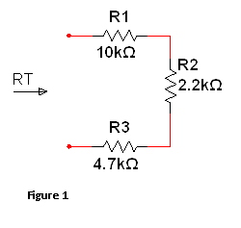
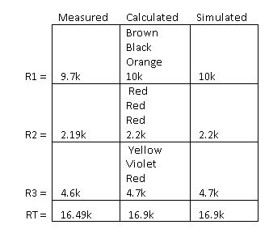
Lab 3- Series Resistors

Slide 7
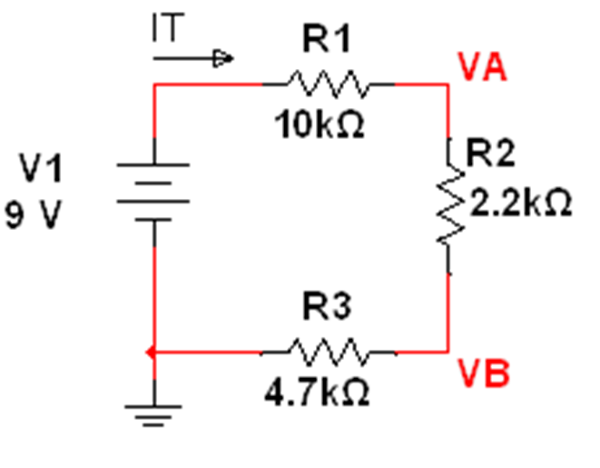
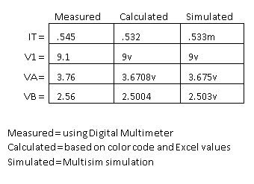
Lab 3- Series Resistors

Slide 8
Lab 3
 | R1 | R2 | R3 | RT
Measured Values | 9.7k | 2.19k | 4.6k | 16.49k
Calculated | 10k | 2.2k | 4.7k | 16.9k
simulated | 10k | 2.2k | 4.7k | 16.9k
 | IT | V1 | VA | VB
Measured Value | 0.545 | 9.1 | 3.76 | 2.56
Calculated | 0.532 | 9 | 3.6708 | 2.5004
simulated | 0.533 | 9 | 3.675 | 2.503

Slide 9
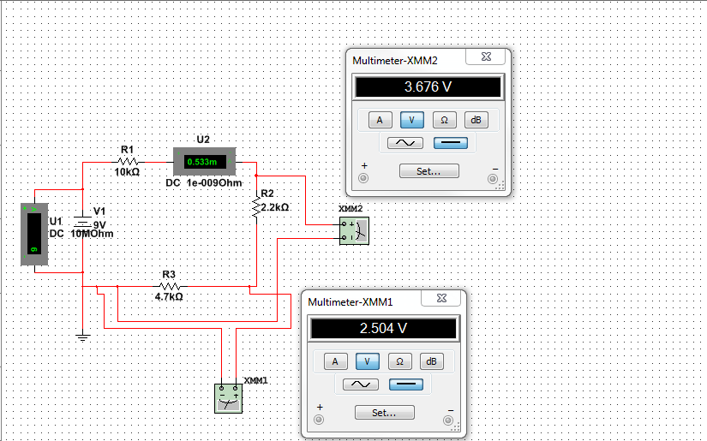
Lab 3- Multisim

Slide 10
Lab 3 Observations
Lab 3 was used to teach a few things. One was to begin using Multisim. Another was to begin building circuits physically. The last was measuring nodal voltages, the resistances, and current within the circuit. There were a few problems with making the circuits physically because I didn’t understand how the wires and resistors should have been placed. After understanding that, the measuring of the circuit was quite simple. All of the readings came out right because we checked the resistors before hand to make sure they were good. We also compared our physical results with the results from the Multisim tests.

Slide 11
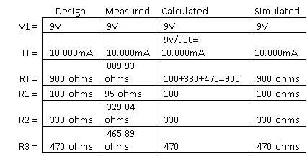
Lab 4- Black Box Design Series Circuit

Slide 12
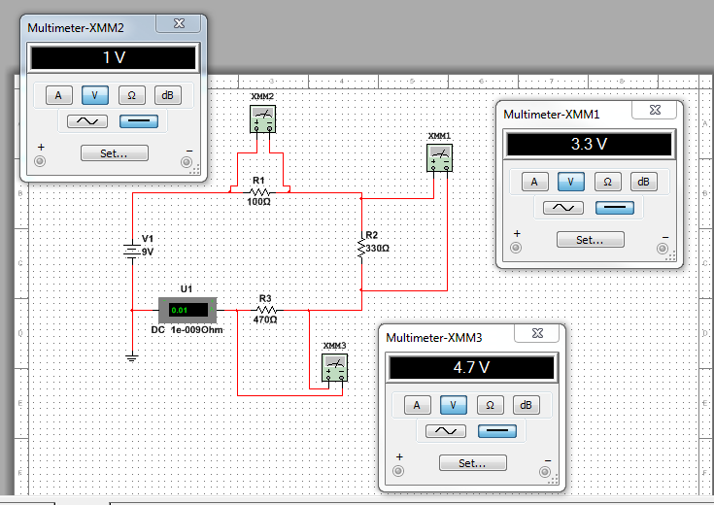
Lab 4- Multisim

Slide 13
Lab 4 Observations
Observations: In order to meet the requirement of 10.000 mA we used the formula, V/I=R, to find the total resistance. Then came up with resistor amounts that, when added up, equaled 900 ohms. This allowed us to meet all the requirements presented in the problem.

Slide 14
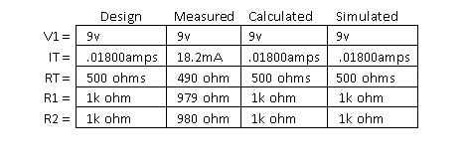
Lab 6- Black Box Design Parallel Circuit

Slide 15
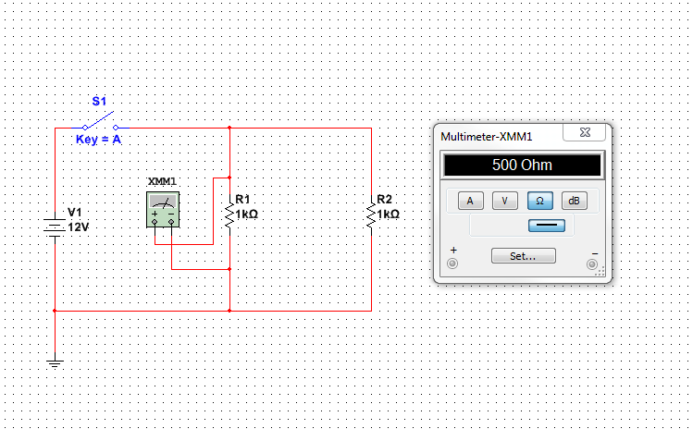
Lab 6- Multisim

Slide 16
Lab 6 Observations
We used ohms law to figure out what we needed within the black box. Using the formula to find the totals allowed us to achieve 18mA. Since this circuit was in parallel, we needed to watch how we added our resistors and how the voltage works since the voltage in parallel circuits stay the same throughout.

Slide 17
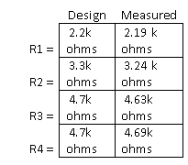
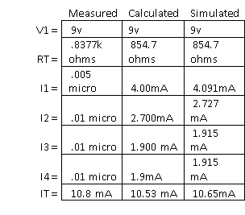
Lab 7- Resistor Parallel Circuit

Slide 18
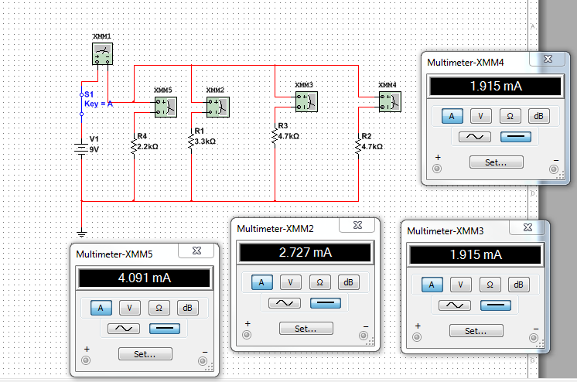
Lab 7 Multisim

Slide 19
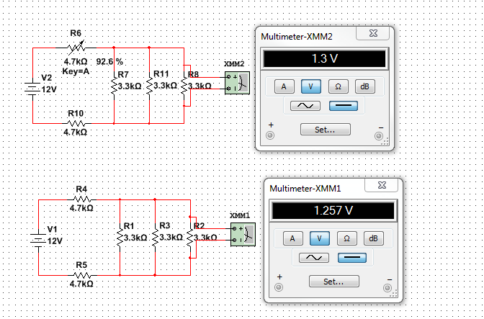
Lab 7 Multisim

Slide 20
Lab 7 Observations
The multimeter that we used to measure the currents, for each resistor, has too small of a scale to read the current’s low readings.

Slide 21
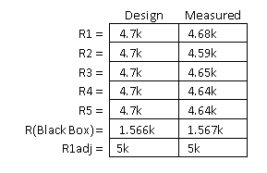
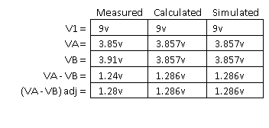
Lab 8- Black Box Design 3 Series and Parallel Mixed

Slide 22
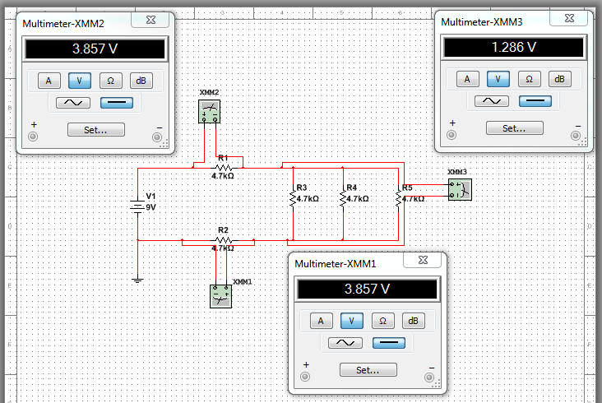
Lab 8- Multisim

Slide 23
Lab 8 Observations
The 5K Ohm pot was difficult to use at first because it was very different than anything we have used before. But the resistor proved to be valuable because you can adjust its resistance without needing to get another resistor to replace it. By adjusting the resistance of the 5k Ohm pot, we were able to meet the requirements in the end of the lab.

Slide 24
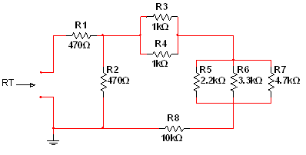
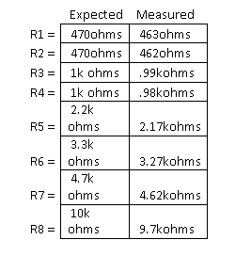
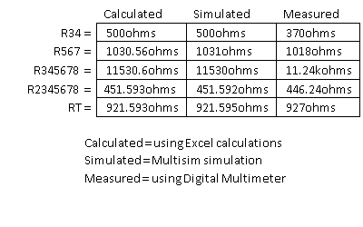
Lab 9- Series/Parallel Resistors

Slide 25
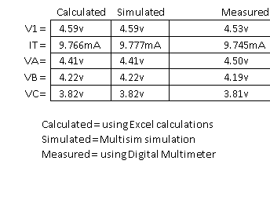
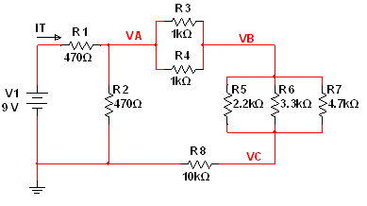
Lab 9- Series/Parallel Resistors

Slide 26
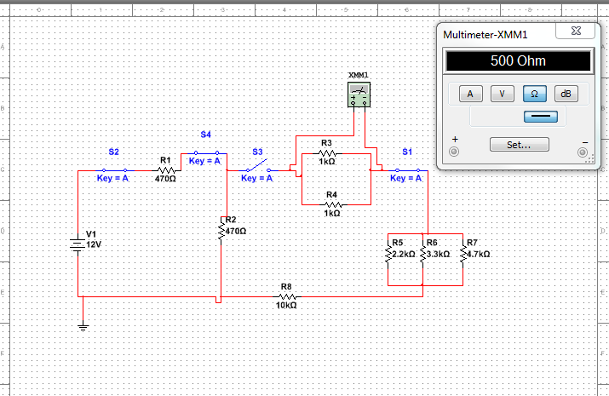
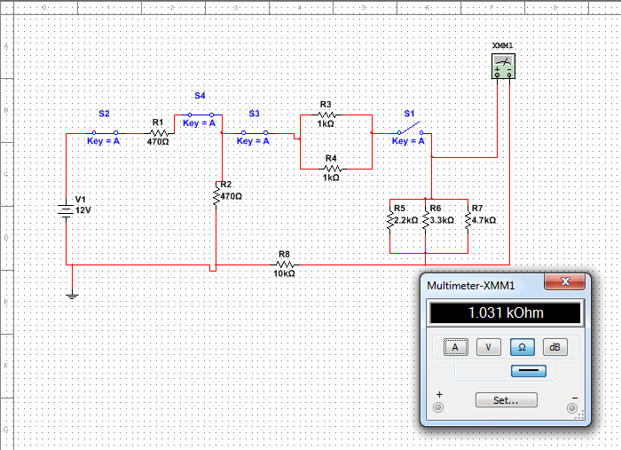
Lab 9 Multisim

Slide 27
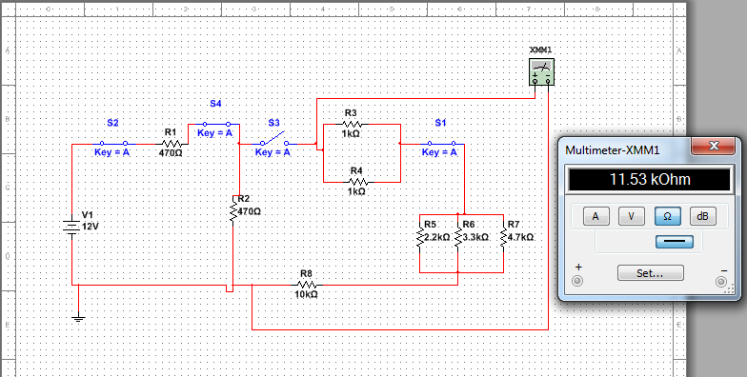
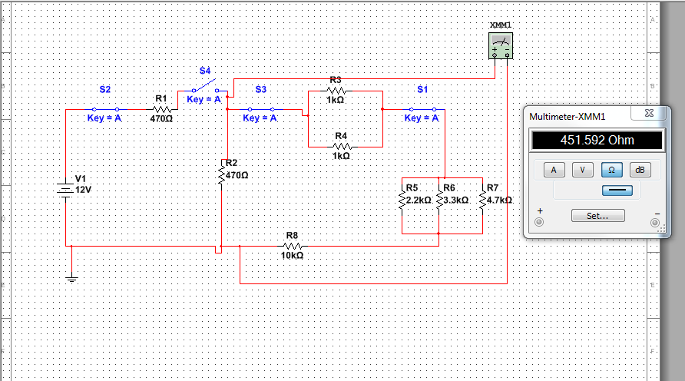
Lab 9 Multisim

Slide 28
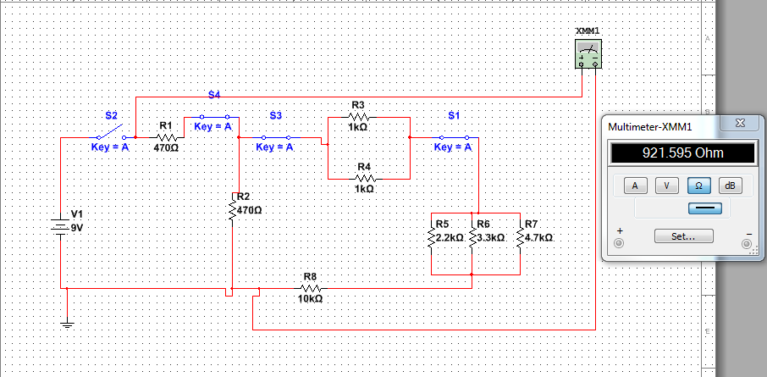
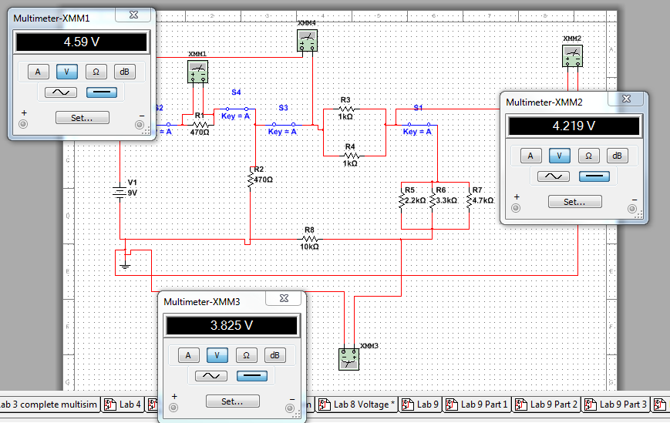
Lab 9 Multisim

Slide 29
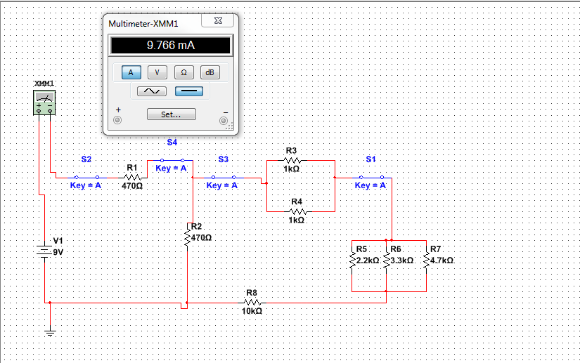
Lab 9 Multisim

Slide 30
Lab 9 Observations
This lab introduced mixed circuits or series and parallel. By starting from the right and going to the left to add the resistors, we were able to figure out the total resistance of the circuit. We experimented and tried other ways of adding them together but we couldn’t get the right result. So by trying other ways, we confirmed to ourselves that there isn’t any other way to get the right answer other than from starting from the right and working our way to the left.

Slide 31
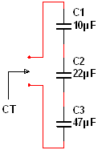
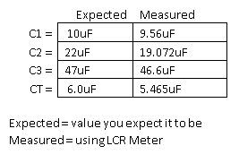
Lab 10- Series/Parallel Capacitors

Slide 32
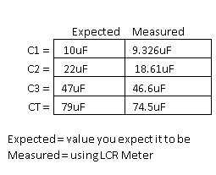

Lab 10- Series/Parallel Capacitors

Slide 33
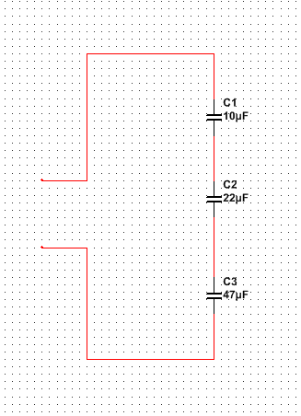
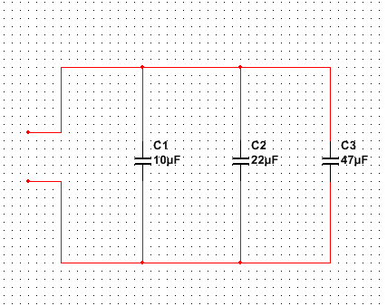
Lab 10- Multisim

Slide 34
Lab 10 Observations
This lab introduced capacitors and how to add and measure them. Capacitors are a little different when adding them together compared to resistors. When capacitors are in parallel, you can simply add there resistances together and get the total. If they are in series, you must put them all under one and then add them together. After that, you must then divide one by the previous total. That gives you the total resistance.

Slide 35
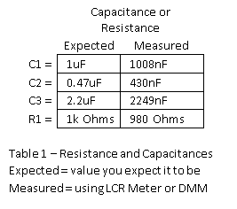
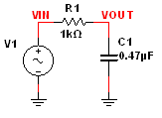
Lab 11- RC Lab

Slide 36
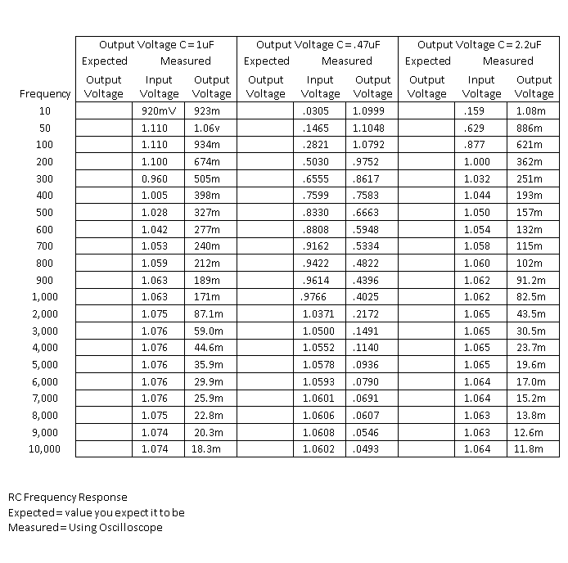
Lab 11- RC Lab

Slide 37
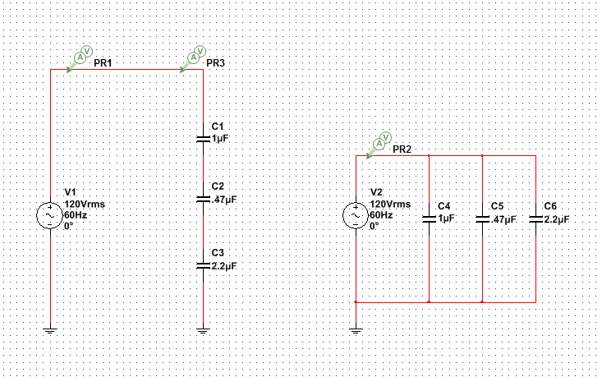
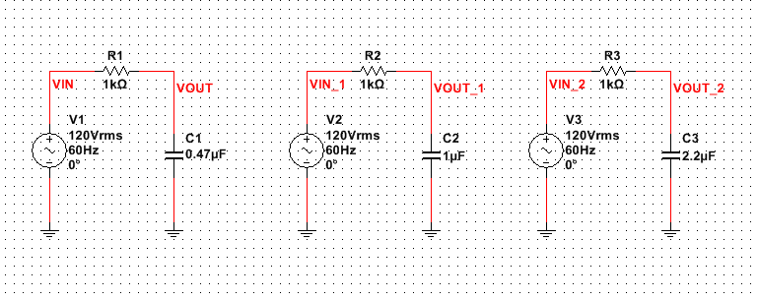
Lab 11- Multisim

Slide 38
Lab 11 Observations
This lab was a little difficult because when we measured using the ohmmeter, we sometimes wouldn’t get the right numbers even though everything was connected right and we were measuring right. The oscilloscope was getting the right measurements though. We both thought that the oscilloscope was easy to use once we knew what everything did.

Slide 39
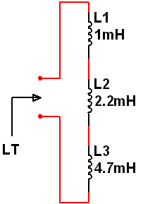
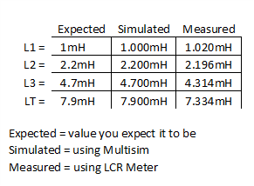
Lab 12- Series/Parallel Inductors

Slide 40
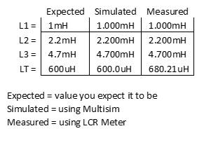
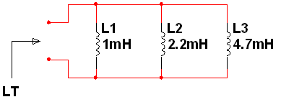
Lab 12- Series/Parallel Inductors

Slide 41
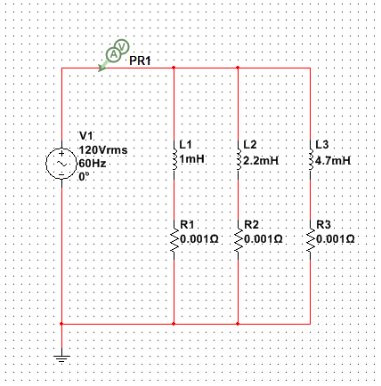
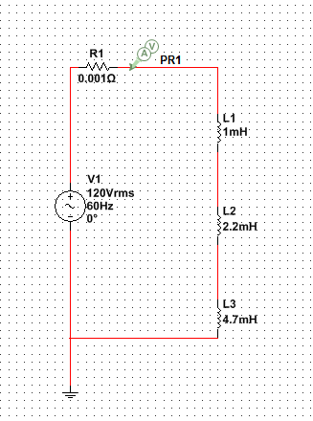
Lab 12- Multisim

Slide 42
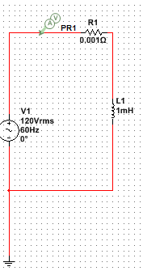
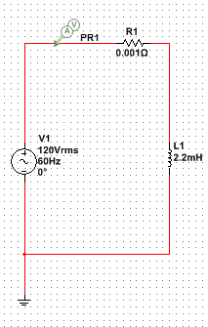
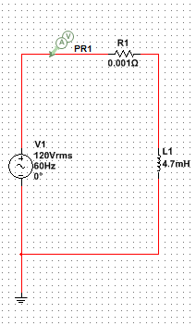
Lab 12- Multisim

Slide 43
Lab 12 Observations
This lab introduced inductors in series and parallel. Getting their totals, like find the total resistance in a series resistor circuit, was quite easy because you can simple add each of the their values together to get their total. They are similar to resistor circuits in that aspect. They follow the same rules with parallel circuits as resistor parallel circuits as well.

Slide 44
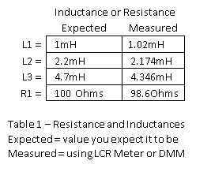
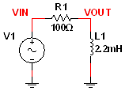
Lab 13- RL Lab

Slide 45
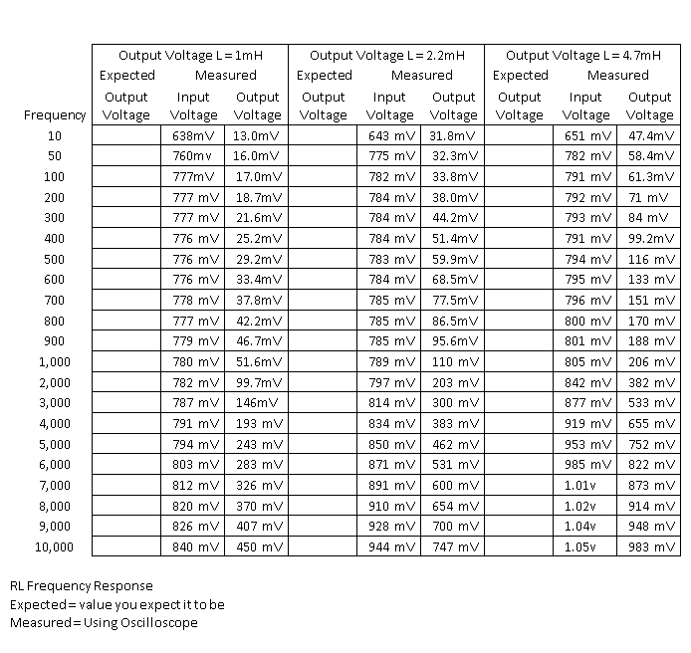
Lab 13- RL Lab

Slide 46



Lab 13- Multisim

Slide 47
Lab 13 Observations
This lab had the same issues as lab 11 with measuring with the ohmmeter. We would sometimes get the right values but for the most part, we had to read the values only from the oscilloscope.

